Slide 1
Detection, Segmentation and Fine-grained Localization
Bharath Hariharan, Pablo Arbeláez, Ross Girshick and Jitendra Malik
UC Berkeley

Slide 2
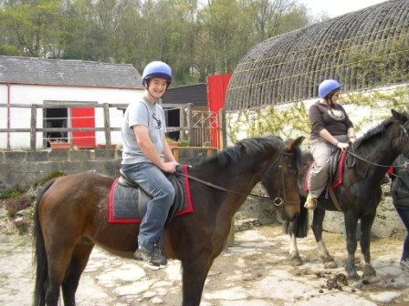
What is image understanding?
Notes:
In computer vision, we typically talk of giving computers the ability to understand images. But what does understanding an image really mean? We as humans actually understand a whole lot from images. Given an image like this, we can very easily figure out, say, the color of the shirt the person on the left is wearing, his head-dress, his expression, the fact that he is smiling, the fact that he is sitting on a horse, with a saddle in front of a house with what looks like a red door beside another person on a horse, probably a woman, looking to the side on another horse that is sort of oriented at like 45 degrees…and so on.

Slide 3
Object Detection
Detect every instance of the category and localize it with a bounding box.
person 1
person 2
horse 1
horse 2
Notes:
Compare the staggering amount of information in that to the output of a standard object detector. The task of the object detector is to detect instances of a category in an image, for instance horses or people, and put a bounding box around each. Thus all the complexity about the objects in the scene is reduced to a set of bounding boxes. Clearly an object detector is a bit far from “image understanding”.
One way in which the understanding of an object detector is far away from our understanding is in localization. We humans are particularly good at delineating these objects: we know precisely where the person ends and where the horse begins. Such pixel-precise segmentations are however beyond the abilities of standard object detectors.
One may argue that we don’t really need such detailed understanding for the target application. Indeed, Bing, or Google may care only about image-level category labels, but a robotics application that is trying to grasp objects, or a graphics application that is trying to cut and paste objects from one scene to another will require a much more precise localization.

Slide 4
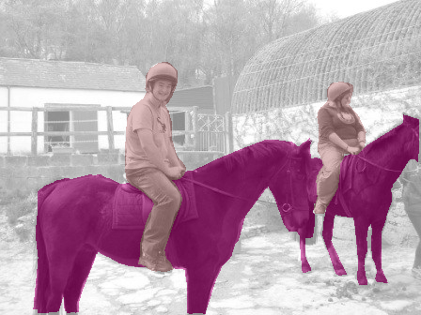
Semantic Segmentation
Label each pixel with a category label
horse
person
Notes:
Semantic segmentation systems do produce pixel precise segmentations, but they don’t separate out individual instances. For this image, a semantic segmentation algorithm would mark a bunch of pixels as horse pixels, or “horse stuff” and a bunch of pixels as person pixels, or “person stuff”. If you were to ask a semantic segmentation algorithm how many horses there are in the image, it will not know. Again, this is deeply unsatisfying, because just looking at this image we humans can not only say that there are exactly two horses, we can also demarcate very easily where one horse ends and the other begins.
This lack of instance-level reasoning is also going to be a problem for our hypothetical robot trying to grasp things, or our putative graphics application. The robot for instance will need to pick up a single cup, and not a mass of “cup stuff”, so it needs to know about individual instances of cups.

Slide 5
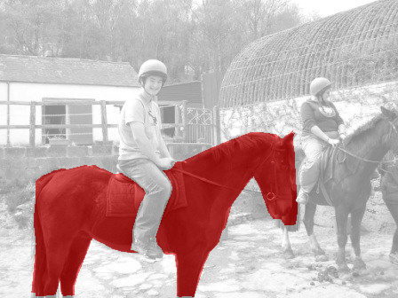
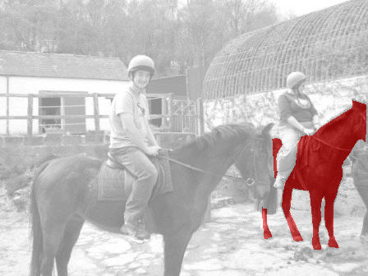
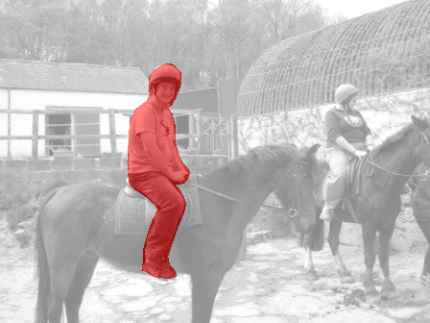
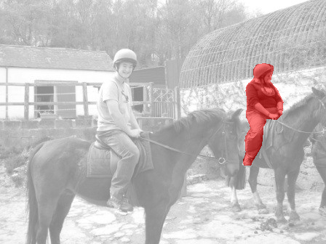
Simultaneous Detection and Segmentation
Detect and segment every instance of the category in the image
horse 1
horse 2
person 1
person 2
Notes:
Our proposal is that we need both instance-level reasoning as well as pixel precise segmentations. We believe that recognition systems should tackle this task: given an image, we want the algorithm to detect every instance of every category in the image, and for each detected instance produce a pixel precise segmentation. Thus, this is the output we desire. We call this task “simultaneous detection and segmentation” or SDS.
In most of this talk I am going to focus on the SDS task, and I will present algorithms and results on this task.
However, SDS is hardly the end goal. The segmentation tells you precisely where the detected object is, but it doesn’t tell you how the object is oriented, and more precisely where its various parts are. Is the horse facing left or right? Where are it’s legs? Where are the person’s hands? Again this sort of understanding can prove very useful. Our hypothetical robot for instance, would really love to know not just where exactly the cup is, but also where the handle of the cup is. More concretely, part level segmentations have been proven to be very useful for making fine-grained classification decisions. For instance, to classify the expression of the person on the left, we may need to know where the face of the person is.

Slide 6
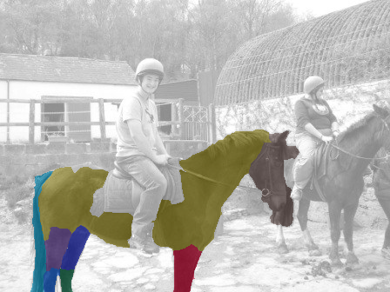
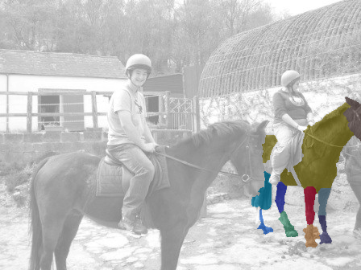
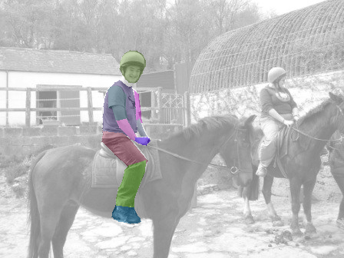
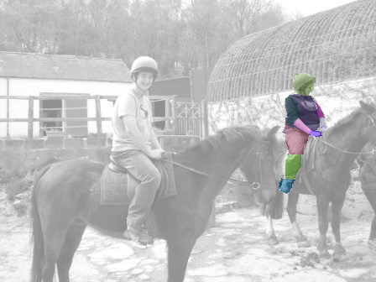
Simultaneous Detection, Segmentation and Part Labeling
Detect and segment every instance of the category in the image and label its parts
horse 1
horse 2
person 1
person 2
Notes:
So we can ask our algorithm to not only output a segmentation for each detected object, but also output a labeling of the various parts of the object. We can call this task “Simultaneous detection, segmentation and part labeling”. I will present some preliminary results on this kind of task too.
However, this isn’t the end goal either. These are just first steps in a long road that leads to ever richer descriptions of objects and hopefully more useful vision algorithms, and that is what I hope to work on in the future.

Slide 7
Goal
A detection system that can describe detected objects in excruciating detail
Segmentation
Parts
Attributes
3D models
…

Slide 8
Outline
Define Simultaneous Detection and Segmentation (SDS) task and benchmark
SDS by classifying object proposals
SDS by predicting figure-ground masks
Part labeling and pose estimation
Future work and conclusion
Notes:
This is the outline of this talk. For most of this talk, I will be talking about the SDS task. I will first describe a method using CNNs to classify bottom-up segmentation proposals. I will then show that you can use the CNNs to improve the bottom-up segmentation process. I will then talk of extending this system to other forms of localization, such as part labeling and pose estimation.

Slide 9
Papers
B. Hariharan, P. Arbeláez, R. Girshick and J. Malik. Simultaneous Detection and Segmentation. ECCV 2014
B. Hariharan, P. Arbeláez, R. Girshick and J. Malik. Hypercolumns for Object Segmentation and Fine-grained Localization. CVPR 2015

Slide 10
SDS: Defining the task and benchmark

Slide 11

Background: Evaluating object detectors
Algorithm outputs ranked list of boxes with category labels
Compute overlap between detection and ground truth box
Overlap =
U

Slide 12

Background: Evaluating object detectors
Algorithm outputs ranked list of boxes with category labels
Compute overlap between detection and ground truth box
Overlap =
U

Slide 13
Background: Evaluating object detectors
Algorithm outputs ranked list of boxes with category labels
Compute overlap between detection and ground truth box
If overlap > thresh, correct
Compute precision-recall (PR) curve
Compute area under PR curve : Average Precision (AP)
Overlap =
U

Slide 14

Evaluating segments
Algorithm outputs ranked list of segments with category labels
Compute region overlap of each detection with ground truth instances
region = overlap
U

Slide 15

Evaluation metric
Algorithm outputs ranked list of segments with category labels
Compute region overlap of each detection with ground truth instances
region = overlap
U

Slide 16
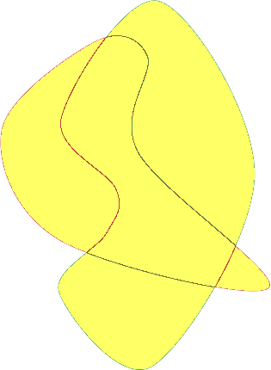
Evaluation metric
Algorithm outputs ranked list of segments with category labels
Compute region overlap of each detection with ground truth instances
region = overlap
U

Slide 17
Evaluating segments
Algorithm outputs ranked list of segments with category labels
Compute region overlap of each detection with ground truth instances
If overlap > thresh, correct
Compute precision-recall (PR) curve
Compute area under PR curve : Average Precision (AP^{r})
region = overlap
U

Slide 18
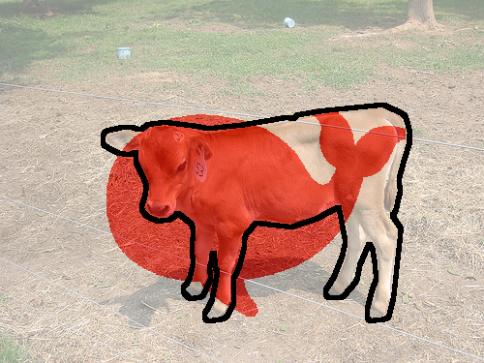
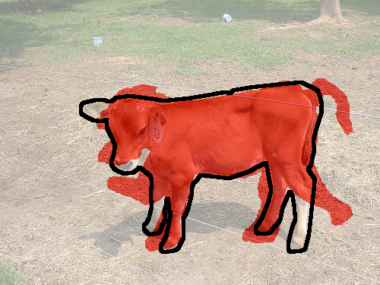
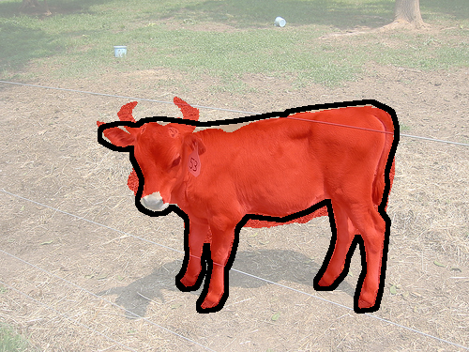
Region overlap vs Box overlap
0.51
1.00
0.72
0.78
0.91
0.91
Slide adapted from Philipp Krähenbühl

Slide 19
SDS by classifying bottom-up candidates

Slide 20
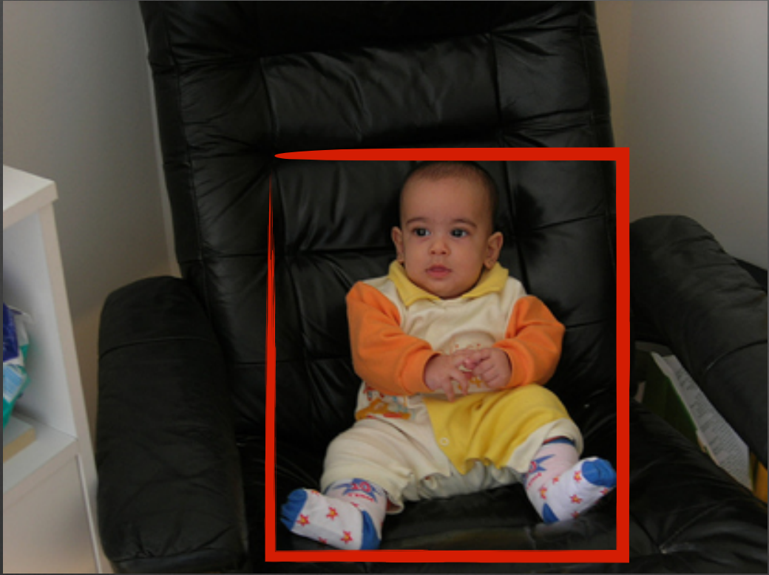
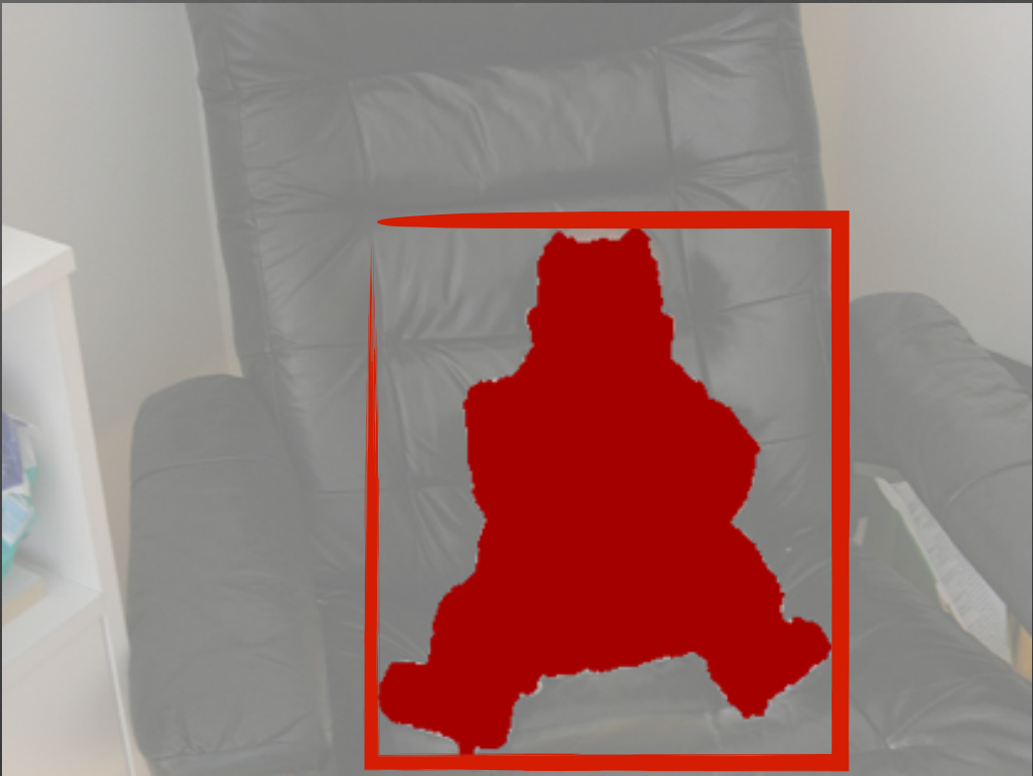
Background : Bottom-up Object Proposals
Motivation: Reduce search space
Aim for recall
Many methods
Multiple segmentations (Selective Search)
Combinatorial grouping (MCG)
Seed/Graph-cut based (CPMC, GOP)
Contour based (Edge Boxes)
Notes:
Before I describe our approach to SDS, I want to give some background, for the sake of completeness and also for those who are not intimately familiar with the latest and greatest in object detection.
For object detection, and even more so for SDS, the space of possible outputs is huge. The number of possible bounding boxes in an image number in the millions, and the number of possible segmentations might be on the order of trillions. It is near impossible for us to exhaustively enumerate all the boxes, let alone segments, and evaluate them in a brute force manner, especially if we want to apply sophisticated classifiers to score each box or segment. Therefore, most state-of-the-art methods first produce a small set (usually a few thousand) of candidate proposals that are then fed into the classifier.
The methods used to propose these candidates cluster along two axes. The first is whether they output bounding box candidates, such as the box above, or segment/region candidates, such as the candidate below. The other axis is the method used to produce candidates. Some like selective search pick regions from multiple segmentation hierarchies. Others, like MCG, use a single hierarchy and combinatorially combine pairs and triplets of regions from the hierarchy. CPMC and GOP use graph cut based techniques to produce their candidates. Finally methods like Edge Boxes directly produce boxes from contours.

Slide 21
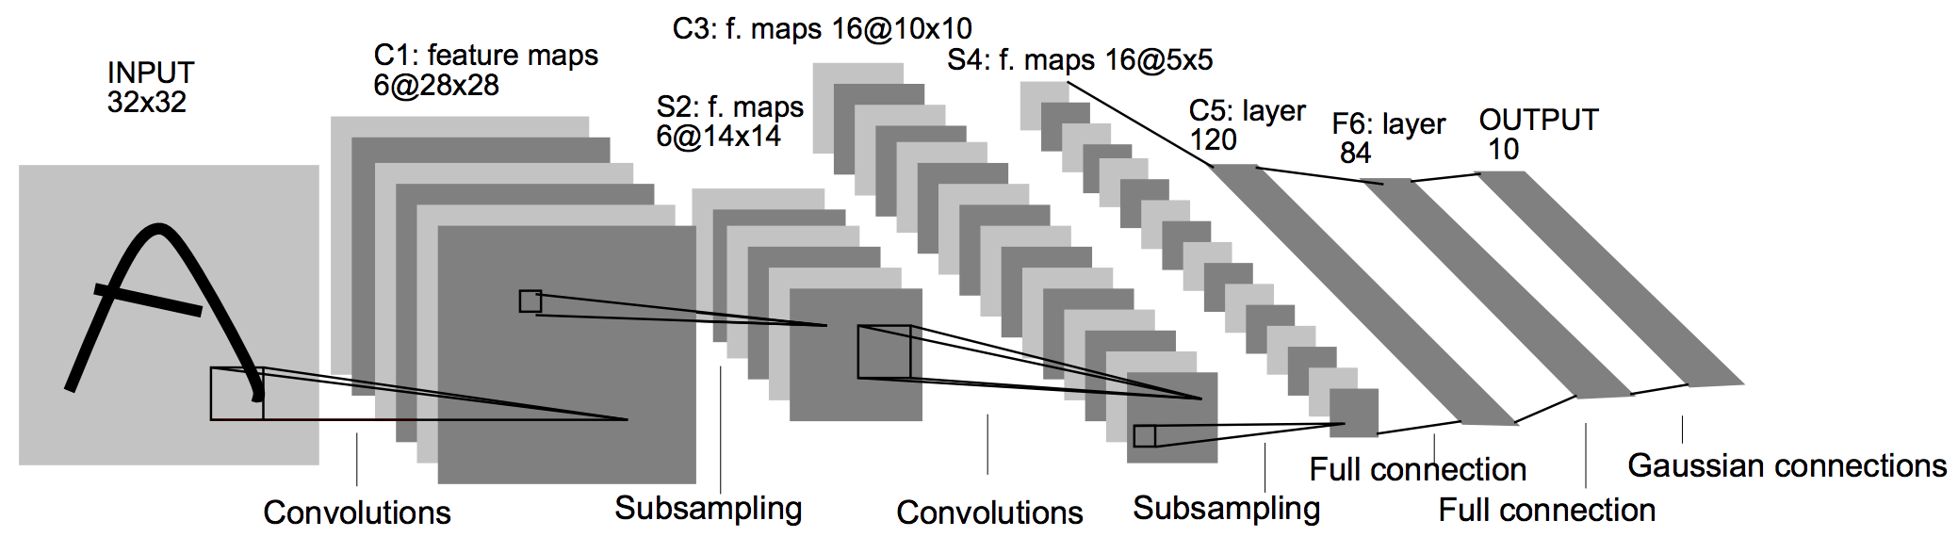
Background : CNN
Neocognitron
Fukushima, 1980
Learning Internal Representations by Error Propagation
Rumelhart, Hinton and Williams, 1986
Backpropagation applied to handwritten zip code recognition
Le Cun et al. , 1989
….
ImageNet Classification with Deep Convolutional Neural Networks
Krizhevsky, Sutskever and Hinton, 2012
Slide adapted from Ross Girshick
Notes:
After producing bottom-up proposals, the next step is to classify them, and what better classifiers than convolutional neural networks? If you work on object recognition, it is hard to miss the mini-revolution of convolutional neural networks that is sweeping the field. Convolutional networks are multilayer perceptrons which have convolutional and pooling layers. Convolutional layers basically apply a filter bank on the previous layers’ output. Pooling layers subsample the output of the previous layer by typically taking the average or maximum response in a small window thus providing invariance to small deformations. This figure here shows an early CNN from Yann LeCun.
The architecture of convolutional networks was described by Fukushima in 1980, and the training procedure using backpropagation was figured out multiple times, including by Rumelhart, hinton and Williams in 1986 and Le Cun et al in 1989. There was a lot of work on recognition using CNNs, but in the absence of large datasets and compute power to train these systems, traditional vision systems based on HOG or SIFT dominated. This was till Krizhevsky et al showed impressive results on the ImageNet challenge and many more recognition people sat up and took notice.

Slide 22
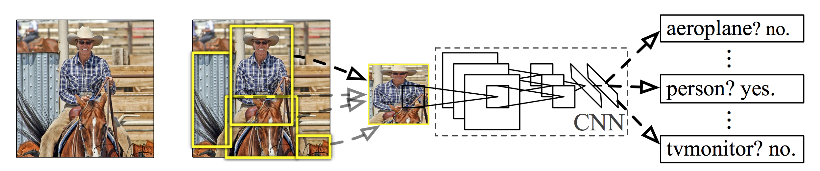
Background : R-CNN
Input Image
Extract box proposals
Extract CNN features
Classify
R. Girshick, J. Donahue, T. Darrell and J. Malik. Rich Feature Hierarchies for Accurate Object Detection and Semantic Segmentation. In CVPR 2014.
Slide adapted from Ross Girshick
Notes:
Ross and his collaborators showed that these CNNs could also be used for object detection by using CNNs to classify bottom-up object proposals from selective search. Each bounding box candidate was expanded slightly to include context, cropped from the image, resized to a square and fed into the CNN. Features from one of the last layers of the CNN were then used to train an SVM to classify the boxes.
R-CNN also showed that it was important to train the CNN for the object detection task, The network was initially pretrained on ImageNEt classification, and then finetuned on the detection dataset. For this finetuning, boxes that overlapped by more than 50% with a ground truth instance were regarded as positive and boxes that overlapped by less than 50% as negative.
R-CNN was a big jump in state-of-the-art in object detection, and still is state-of-the-art.

Slide 23
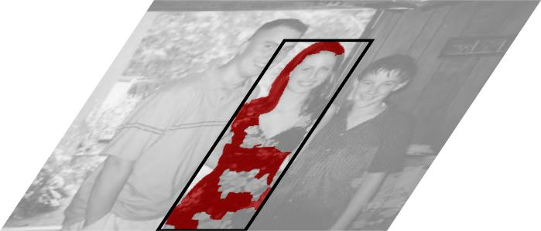
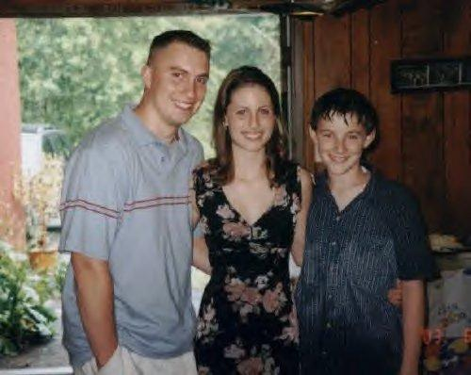
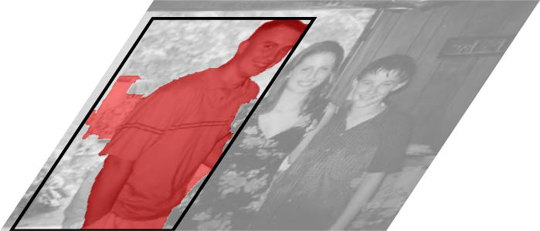
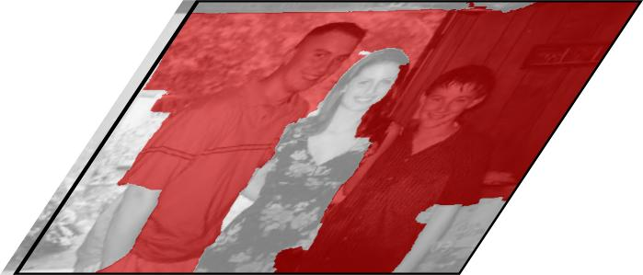
From boxes to segments Step 1: Generate region proposals
P. Arbeláez*, J. Pont-Tuset*, J. Barron, F. Marques and J. Malik. Multiscale Combinatorial Grouping. In CVPR 2014
Notes:
Our SDS pipeline is similar to the R-CNN pipeline. Because we are interested in producing segmentations and not bounding boxes, we use MCG to propose candidate segments. MCG works by building a bottom-up segmentation hierarchy, combinatorially merging pairs or triplets of regions from the hierarchy to form candidates, and ranking them using simple geometrical properties. These are some example candidates you get.
Our approach is not specific to MCG and can work with any initial segment candidates.

Slide 24
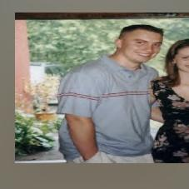
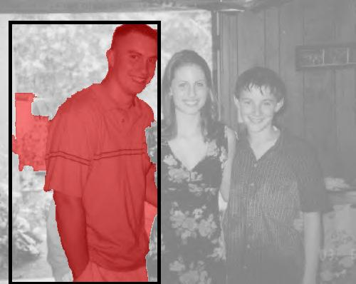
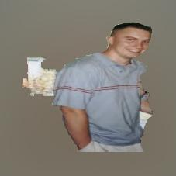
From boxes to segments Step 2: Score proposals
Box CNN
Region CNN
Notes:
We then classify each candidate. As in R-CNN, we take the bounding box of the candidate and expand It a little to capture context. We then crop the box out of the image and feed it into a CNN (which I am calling here the “Box CNN”) and take features from one of the top layers to get one set of features. However, this set of features is completely unaware of what the segmentation actually was.
We compute another set of features by setting the region background to the image mean and passing it into a second CNN (which I will call the “Region CNN”). The two sets of features are concatenated together to form the feature vector of the region.

Slide 25
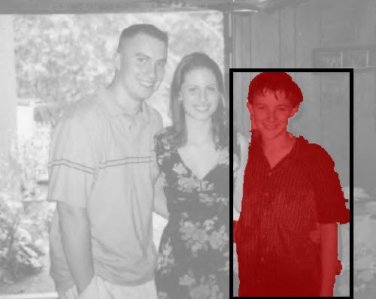
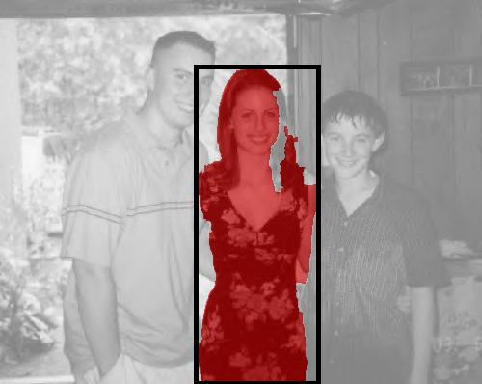
From boxes to segments Step 2: Score proposals
Person?
+3.5
Box CNN
+2.6
Region CNN
+0.9
Notes:
We then train an SVM to classify the region candidate using this concatenated feature vector. We get a separate score for each category. I’m showing here the top 3 highest scoring candidates (after nms) for the person category in this image.

Slide 26
Network training
Joint task-specific training
Good region? Yes
Loss
Box CNN
Train entire network as one with region labels
Region CNN

Slide 27
Network training
Baseline 1: Separate task specific training
Good box? Yes
Good region? Yes
Loss
Loss
Box CNN
Region CNN
Train Box CNN using bounding box labels
Train Region CNN using region labels

Slide 28
Network training
Baseline 2: Copies of single CNN trained on bounding boxes
Good box? Yes
Loss
Box CNN
Region CNN
Box CNN
Train Box CNN using bounding box labels
Copy the weights into Region CNN

Slide 29
Experiments
Dataset : PASCAL VOC 2012 / SBD [1]
Network architecture : [2]
Joint, task-specific training works!
 | AP^{r} at 0.5 | AP^{r} at 0.7
Joint | 47.7 | 22.9
Baseline 1 | 47.0 | 21.9
Baseline 2 | 42.9 | 18.0
B. Hariharan, P. Arbeláez, L. Bourdev, S. Maji and J. Malik. Semantic contours from inverse detectors. ICCV (2011)
A. Krizhevsky, I. Sutskever and G. E. Hinton. Imagenet classification with deep convolutional networks. NIPS(2012)
Notes:
Let us now see how this pipeline fares. We run all our experiments on the PASCAL VOC 2012 set, using the train set for training and the val set for testing. We use segmentation annotations we collected and made public as part of a previous paper. The segmentation annotation dataset is called SBD.
Our metric for evaluation is a twist on the standard object detection metric. The algorithm outputs a set of ranked detections each of which also have an associated segmentation. Each such detected segment is then compared to ground truth instance segmentations using region overlap. Note that this is region overlap and not box overlap. If the best matching ground truth instance overlaps the candidate by more than a threshold, then the candidate is marked as a true positive, and the corresponding ground truth instance is marked as covered and removed from the ground truth pool to penalize duplicates. Otherwise the detection is a false positive.
Once all the detections have been marked as true or false, a precision recall curve is computed and the area under the curve is our metric, called APr

Slide 30
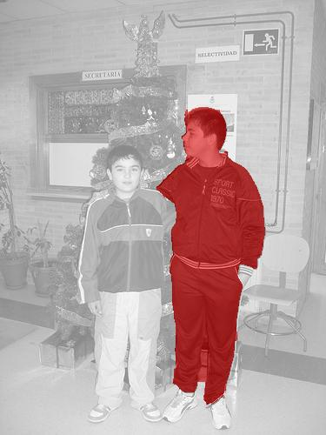
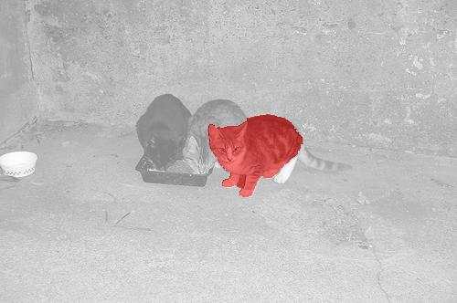
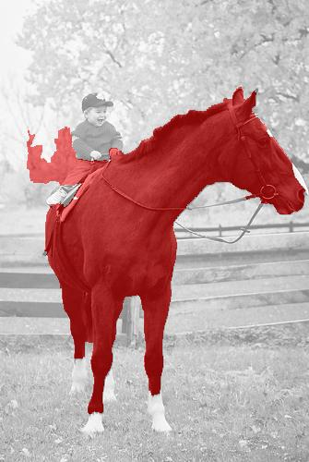
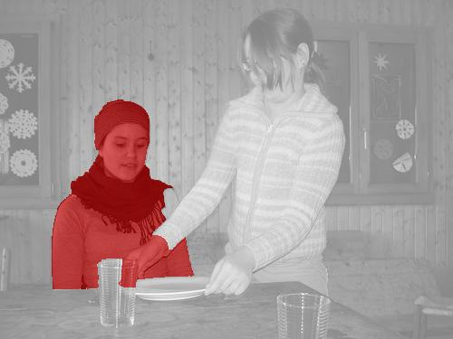
Results

Slide 31
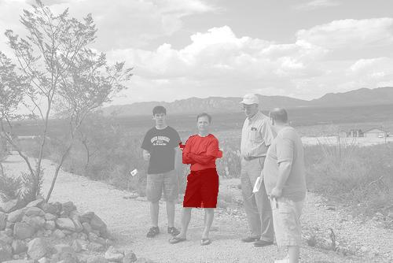
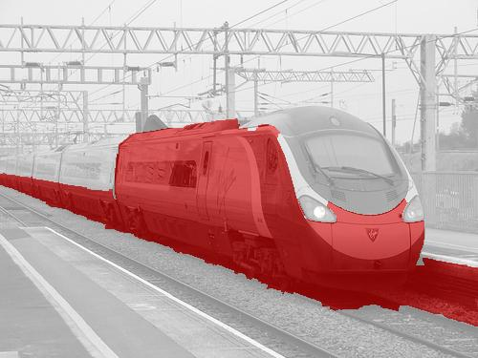
Error modes

Slide 32
SDS by top-down figure-ground prediction

Slide 33
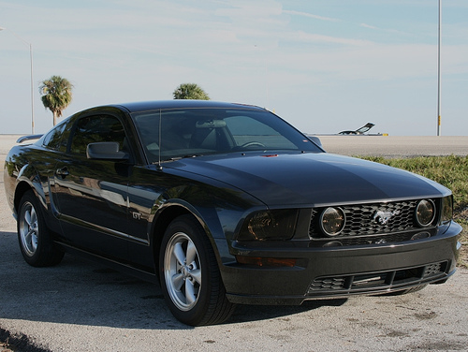
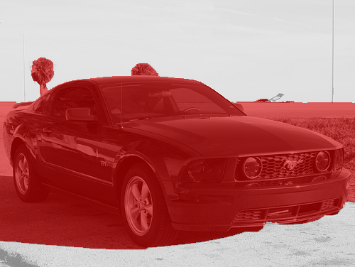
The need for top-down predictions
Bottom-up processes make mistakes.
Some categories have distinctive shapes.
Notes:
One suboptimality in this pipeline is that we are relying quite heavily on the bottom-up segmentation process to produce good proposals. But these bottom-up processes can make some mistakes and we have no way of recovering from that. For instance, in the car here, the shadow on the road is dark and so gets grouped along with the car. This is especially embarassing in this case because this car has a very prototypical shape, and so we should be able to use our knowledge of car shapes to correct this missegmentation.All this points towards using a top-down prediction of figure-ground to refine the segmentation.
The pipeline of first classifying bottom-up segmentation proposals and then classifying them and then refining them is a bit expensive, partly because of having to deal with two large convolutional networks, and two large feature vectors. If our top down figure ground prediction works well, then it raises an intriguing possibility: can we do bounding box detection, and simply make a top-down fg prediction for each detection? This will allow us to leverage the large body of work going on in doing bounding box detection, besides making the entire pipeline quite a bit simpler.

Slide 34
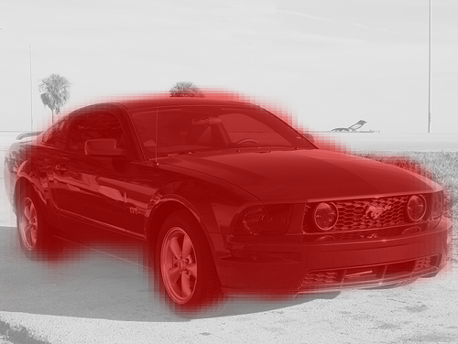
Top-down figure-ground prediction
Pixel classification
For each p in window, does it belong to object?
Idea: Use features from CNN
Notes:
We approached the problem of top down figure ground prediction as one of pixel classification: for every pixel p in the window, we want to ask if the pixel is in the object or in the background. To make this figure-ground prediction, we wanted to use features from the CNNs that we had already trained.

Slide 35
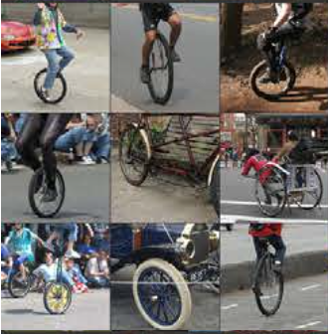
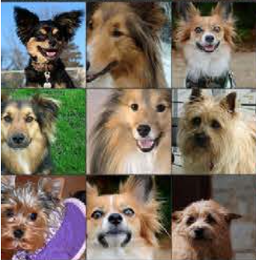
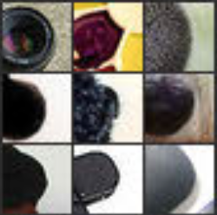
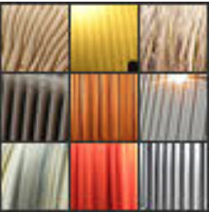
CNNs for figure-ground
Idea: Use features from CNN
But which layer?
Top layers lose localization information
Bottom layers are not semantic enough
Our solution: use all layers!
Layer 5
Layer 2
Figure from : M. Zeiler and R. Fergus. Visualizing and Understanding Convolutional Networks. In ECCV 2014.
Notes:
The question of course was which layer? Unlike the case of classification, the answer is not straightforward. To see this, here are the highest scoring patches for two units in the second layer of the network and for two units in the fifth layer of the network. As you can see, the units in layer 5 are highly class selective as you can see: the one seems to be mostly firing on bicycle wheels while the other seems to fire on dog faces. However, the unit is highly invariant to where exactly the dog face occurs : to the left, to the right, zoomed in, or to the orientation of the wheel. Using these kinds of units to predict segmentation is hard because while they will get the category label right, they can’t localize very well where the object is and how it is oriented.
On the other hand the units in layer 2 seem to be selective for highly localized, relatively low level features: a dark disc in one case and a vertical texture in another. It precisely localizes these things as you can see for the disc, but the features are hardly semantic. Units in this layer will precisely tell you where the feature they found is, but it is hard to say if the feature they found is part of a horse or a person or background.
Our solution to this conundrum is to simply to use all layers. (In practice we sample 3 layers roughly equallys paced in the network). For instance, if we see that both the disc-detecting unit 2 neuron and the bicycle wheel detecting unit 5 neuron has fired, then we know both that we have found a bicycle wheel and where precisely the wheel is.

Slide 36


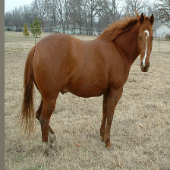
Resize
convolution+ pooling
Resize
convolution+ pooling

Slide 37
Hypercolumns*
*D. H. Hubel and T. N. Wiesel. Receptive fields, binocular interaction and functional architecture in the cat’s visual cortex. The Journal of physiology, 160(1), 1962.
Also called jets: J. J. Koenderink and A. J. van Doorn. Representation of local geometry in the visual system. Biological cybernetics, 55(6), 1987.
Also called skip-connections: J. Long, E. Schelhamer and T. Darrell. Fully Convolutional Networks for Semantic Segmentation. arXiv preprint. arXiv:1411.4038

Slide 38
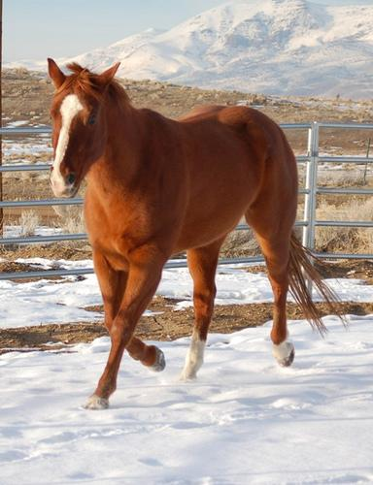

Analogy with image pyramids
Hard : large coarse displacements
Easy : small fine deformations
Easy : large coarse displacements
Hard : small fine deformations
Notes:
To get some intuition, consider the analogy with image pyramids. Pyramids are ubiquitous in computer vision because they allow coarse-to-fine processing. If for instance you wanted to compute optical flow, then you would compute a Gaussian pyramid

Slide 39
Analogy with image pyramids
Hard : large coarse displacements
Easy : small fine deformations
Easy : large coarse displacements
Hard : small fine deformations
Notes:
To get some intuition, consider the analogy with image pyramids. Pyramids are ubiquitous in computer vision because they allow coarse-to-fine processing. If for instance you wanted to compute optical flow, then you would compute a Gaussian pyramid

Slide 40
Analogy with image pyramids
High resolution “vertical bar” detector
Medium resolution “animal leg” detector
High resolution “horse” detector

Slide 41
Hypercolumns
Layer outputs are feature maps
Concatenate to get hypercolumn feature maps
Feature maps are of coarser resolution
Resize (bilinear interpolate) to image resolution

Slide 42
Efficient pixel classification
Upsampling large feature maps is expensive!
Linear classification ( bilinear interpolation ) = bilinear interpolation ( linear classification )
Linear classification = 1x1 convolution
extension : use nxn convolution
Classification = convolve, upsample, sum, sigmoid
Notes:
We get around this issue using a simple trick. Note that if I have to first bilinearly upsample a large feature map, and then run a linear classifier on it, the upsampling and the classification operations are linear and hence can be switched. So I can instead first run the linear classifier, and upsample the single response. In our case, instead of upsampling multiple feature maps, concatenating them and then feeding it into a classifier, we can first divide the classifier into blocks corresponding to these classifiers, run the classifier on each feature map first, and then upsample everything to the full image resolution and sum.

Slide 43
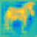
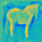

convolution
resize
convolution+ pooling
convolution
resize
convolution+ pooling
Hypercolumn classifier

Slide 44
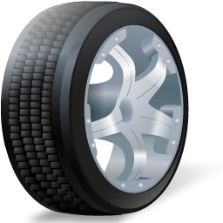
Using pixel location

Slide 45
Using pixel location
Separate classifier for each location?
Too expensive
Risk of overfitting
Interpolate into coarse grid of classifiers
f ( x ) = α f₂(x) + ( 1 – α ) f₁(x )
α
f₁(•)
x
f₂(•)
f₃(•)
f₄(•)
Notes:
Finally, one other piece of information we want to use to do the classification is the location of the pixel in the window: a leg like pixel occuring in the bottom of the window is more likely to be part of the object than a similar pixel occuring at the top. This kind of reasoning is highly non-linear. The naïve thing to do is to have a separate classifier for each pixel in the window, but this will be very expensive and might also overfit, given the huge number of parameters.
Instead what we do is to have a coarse grid of classifiers and interpolate between them using a simple extension of bilinear interpolation. For example, consider the 1D case. f_1,…f_4 are classifiers sitting on a 4 x 1 grid. Given a pixel x which lies between the first and second grid points, we take the output of both f_1 and f_2 on x, and interpolate between the two values.

Slide 46
Representation as a neural network
Notes:
This whole pixel classification pipeline can be written down as additional layers grafted on to the original network. Each of the grid classifiers consists of doing convolutions, upsampling the result, adding this over layers and then passing through a sigmoid. A final classifier interpolation layer gives the final top-down prediction.

Slide 47
Using top-down predictions
For refining bottom-up proposals
Start from high scoring SDS detections
Use hypercolumn features + binary mask to predict figure-ground
For segmenting bounding box detections
Notes:
Now let’s come to the experiments. In our first set of experiments, we are going to see if we can use these hypercolumn features to refine the bottom-up candidates. To do so, we are going to use the hypercolumn features, plus the original zero-one mask of the candidate, as features to predict the new mask for the candidate. In this setting, we will also evaluate how important the idea of using multiple layers is, and if our coarse grid of classifiers buys us anything.

Slide 48
Refining proposals
 | AP^{r} at 0.5 | AP^{r} at 0.7
No refinement | 47.7 | 22.8
Top layer (layer 7) | 49.7 | 25.8
Layers 7, 4 and 2 | 51.2 | 31.6
Layers 7 and 2 | 50.5 | 30.6
Layers 7 and 4 | 51.0 | 31.2
Layers 4 and 2 | 50.7 | 30.8
Notes:
The first thing we see is that even just using the top layer of the network gives us a significant jump: a 2 point jump in AP at 50% threshold and a 3 point jump in AP at 70% threshold. However, using 3 different layers, roughly equally spaced in the network, gives another 1.5 point boost at 50% threshold and a huge 6 point boost at 70% threshold, indicating that using the lower layers helps to make the localization more precise.

Slide 49
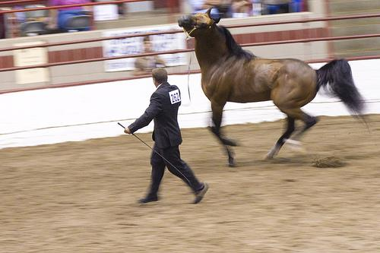
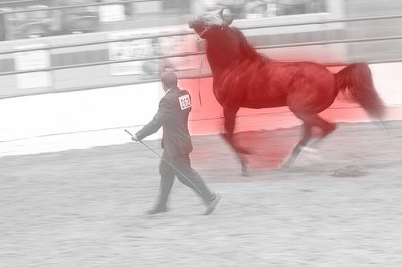
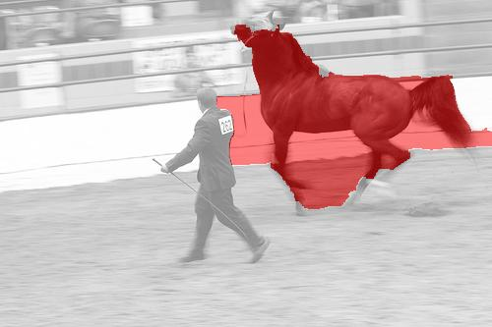
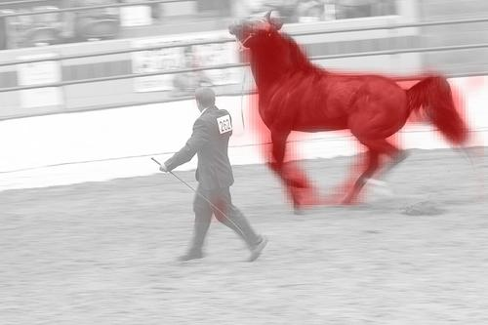
Refining proposals: Using multiple layers
Image
Layer 7
Bottom-up candidate
Layers 7, 4 and 2
Notes:
Here are some examples where using multiple layers helps. The top layer only gives a rough gaussian blob, whereas using 3 layers is able to precisely localize the horse’s legs even though the pose is not prototypical.

Slide 50
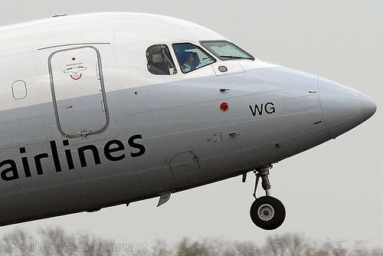



Refining proposals: Using multiple layers
Image
Layer 7
Bottom-up candidate
Layers 7, 4 and 2
Notes:
Here is another example. Again, using multiple layers helps to precisely localize the aeroplane nose.

Slide 51
Refining proposals: Using location
Grid size | AP^{r} at 0.5 | AP^{r} at 0.7
1x1 | 50.3 | 28.8
2x2 | 51.2 | 30.2
5x5 | 51.3 | 31.8
10x10 | 51.2 | 31.6
Notes:
Next we see how important it is to use location. We tried 4 different grid sizes. Note that a grid size of 1 x 1 means that there was only one classifier that was run at all locations. The impact of this is the greatest at 70% overlap threshold, where a 5 x 5 grid gives a 3 point gain compared to using no grid at all.

Slide 52




Refining proposals: Using location
1 x 1
5 x 5
Notes:
Here are examples where using a grid helps. The grid of classifiers helps to make the predictions sharper.

Slide 53
Refining proposals: Finetuning and bbox regression
 | AP^{r} at 0.5 | AP^{r} at 0.7
Hypercolumn | 51.2 | 31.6
+Bbox Regression | 51.9 | 32.4
+Bbox Regression+FT | 52.8 | 33.7
Notes:
Finally, as I mentioned earlier, the top-down prediction system can be considered as a few additional layers grafted onto the original network. This allows the whole system to be finetuned fpr this task. This finetuning buys us an additional point at 50% threshold and at 70% threshold.

Slide 54





Segmenting bbox detections
Notes:
As you can see, it in fact works quite well. It gets details such as the legs of the horse and the bird, as well as figures out occlusion such as in the case of this woman lying on a sofa or this person riding a bike.

Slide 55
Segmenting bbox detections
 | Network | APr at 0.5 | APr at 0.7
Classify segments + Refine | T-net[1] | 51.9 | 32.4
Segment bbox detections | T-net | 49.1 | 29.1
Segment bbox detections | O-net[2] | 56.5 | 37.0
A. Krizhevsky, I. Sutskever and G. E. Hinton. Imagenet classification with deep convolutional networks. NIPS(2012)
K. Simonyan and A. Zisserman. Very deep convolutional networks for large-scale image recognition. arXiv preprint arXiv:1409.1556, 2014
Notes:
Here is how this new pipeline fares compared to the old one. System 1 is the original pipeline based on classifying and refining box proposals, while System 2 is the new pipeline. T-net and O-net are two architectures, the first by Krizhevsky et al and the second by Simonyan et al. All the results I have described till now are using T-net which is much smaller than O-net. O-net is larger, better performing and more expensive.
As you can see, without rescoring, system 2 gives a 3 point loss over system 1, but is more than offset by the large gains we get by using O-net. Our final system with the O-net and the rescoring achieves close to a 60 percent APr at 0.5, and a 40% APr at 0.7.

Slide 56
Segment + Rescore
Notes:
We therefore came up with a new SDS pipeline that is easier to work with. We start with bounding box detections, and expand this set to include some nearby detections that may be better localized. For each detection in this expanded set, we produce a segmentation, and then we rescore it using a concatenation of the box features and the region features. This makes feature computation roughly half as costly, since we only need to compute region features on a small number of candidates. This allowed us to experiment with much more massive CNN architectures that would otherwise be prohibitive to work with.

Slide 57
Segmenting bbox detections
 | Network | APr at 0.5 | APr at 0.7
Classify segments + Refine | T-net[1] | 51.9 | 32.4
Segment bbox detections | T-net | 49.1 | 29.1
Segment bbox detections | O-net[2] | 56.5 | 37.0
Segment bbox +Rescore | O-net | 60.0 | 40.4
A. Krizhevsky, I. Sutskever and G. E. Hinton. Imagenet classification with deep convolutional networks. NIPS(2012)
K. Simonyan and A. Zisserman. Very deep convolutional networks for large-scale image recognition. arXiv preprint arXiv:1409.1556, 2014
Notes:
Here is how this new pipeline fares compared to the old one. System 1 is the original pipeline based on classifying and refining box proposals, while System 2 is the new pipeline. T-net and O-net are two architectures, the first by Krizhevsky et al and the second by Simonyan et al. All the results I have described till now are using T-net which is much smaller than O-net. O-net is larger, better performing and more expensive.
As you can see, without rescoring, system 2 gives a 3 point loss over system 1, but is more than offset by the large gains we get by using O-net. Our final system with the O-net and the rescoring achieves close to a 60 percent APr at 0.5, and a 40% APr at 0.7.

Slide 58






Qualitative results

Slide 59





Qualitative results

Slide 60



Error modes
Multiple objects
Non-prototypical poses
Occlusion

Slide 61
Summary of SDS
Notes:
In summary, this is the trajectory of how the APr at 0.7 has improved in the course of this talk. We started from somewhere around 15 and ended somewhere around 40. There are still 60 points worth of performance to go!

Slide 62



Part Labeling
Same (hypercolumn) features, different labels!
Notes:
The hypercolumn features I described here could just as well be used to train a part classifier, where for each pixel I predict which part th epixel belongs to. It amounts to just retraining the classifiers with a different set of labels!

Slide 63
Part Labeling - Experiments
Dataset: PASCAL Parts [1]
Evaluation: Detection is correct if #(correctly labeled pixels) / union > threshold
 | Bird | Cat | Cow | Dog | Horse | Person | Sheep
Layer 7 | 15.4 | 19.2 | 14.5 | 8.5 | 16.6 | 21.9 | 38.9
Layers 7, 4 and 2 | 14.2 | 30.3 | 21.5 | 14.2 | 27.8 | 28.5 | 44.9
X. Chen, R. Mottaghi, X. Liu, S. Fidler, R. Urtasun and A. Yuille. Detect What You Can: Detecting and Representing Objects using Holistic Models and Body Parts . CVPR 2014
Notes:
We use the PASCAL part dataset recently released by X. Chen et al. To evaluate, we modify the AP^r metric by modifying the IU to take parts into account. Instead of simply doing intersection over union, we only count pixels in the intersection if the predicted part label is also correct.
Unfortunately there is no prior work on this. However, as can be seen, using multiple layers instead of just the top one gives quite a significant boost.

Slide 64



Error modes
Disjointed parts
Misclassification
Wrong figure/ground

Slide 65
Conclusion
A detection system that can
Provide pixel accurate segmentations
Provide part labelings and pose estimates
A general framework for fine-grained localization using CNNs.

